Slide 1


DIGITAL NOTICE BOARD SYSTEM
SUPERVISOR Mr.A.Malarmannan,M.E.,, AP/CSE.
PRESENTED BY
2303811710421153 – SOMESHVAR S

Slide 2

PRESENTATION OVERVIEW
Objective
Project Introduction
Problem Statement
Methodologies (Programming concepts relevant to problem statement)
Architecture of the proposed system
List of Modules
Merits
Results and Discussion
Queries

Slide 3
OBJECTIVE
The objective of the WeatherForecast program is to create a simple graphical user interface (GUI) application in Java that allows a user to input a city name and retrieve the current weather forecast for that city using the OpenWeatherMap API. The program then displays the weather details, including temperature, humidity, and general weather condition (e.g., clear, cloudy) in a text area.
Key Features:
City Input: The program allows users to enter the name of the city whose weather they wish to check.
Weather Data Fetching: It sends an HTTP GET request to the OpenWeatherMap API and retrieves weather information in JSON format.

Slide 4
PROJECT INTRODUCTION
                The Weather Forecasting System is a simple Java-based desktop application that allows users to retrieve and view the current weather forecast for a specific city. By leveraging the OpenWeatherMap API, the application fetches real-time weather data and displays key information such as temperature, humidity, and weather conditions in a graphical user interface (GUI).
                Purpose:
                The main purpose of this project is to provide users with a quick and easy way to check the weather in any city around the world. The application is designed to be simple, intuitive, and responsive, allowing users to enter a city name and instantly receive weather details.
                Objectives:
                Real-time Weather Information: The application fetches current weather data from the OpenWeatherMap API, providing accurate and up-to-date weather conditions.
                Graphical User Interface (GUI): The application is built using Java's AWT library to create a basic GUI. It allows users to enter a city name, click a button to fetch weather data, and view the results in a text area.

Slide 5
PROBLEM STATEMENT
The Weather Forecasting System aims to address the challenge of providing users with real-time weather information for any city across the globe in an easy-to-use desktop application. Often, users need a quick way to check weather conditions, including temperature, humidity, and overall weather conditions (e.g., clear, cloudy, rainy), but may not have access to a reliable or intuitive platform. This system leverages the OpenWeatherMap API to fetch current weather data based on the city name entered by the user, ensuring the application provides up-to-date and accurate information. The problem this system solves is the need for a simple, accessible, and efficient way for individuals to obtain weather information without having to rely on more complex or cluttered applications. The solution offers a user-friendly graphical interface, where users can input a city name and instantly view key weather details, making it suitable for anyone with basic computing skills. Additionally, the system handles errors such as incorrect city names or connectivity issues, ensuring a smooth user experience.

Slide 6
Methodologies (Programming concepts relevant to problem statement)
The Weather Forecasting System utilizes key object-oriented programming principles such as inheritance, polymorphism, encapsulation, and event-driven programming to manage weather-related data, handle user input, and display results through a graphical user interface. The use of inheritance allows for easy window management through the Frame class, while polymorphism enhances the interaction between the user and the application. Encapsulation helps organize the system's data and methods in a single class, ensuring cleaner and more maintainable code. Through these methodologies, the system achieves a simple yet effective solution for fetching and displaying weather data in a user-friendly interface.

Slide 7
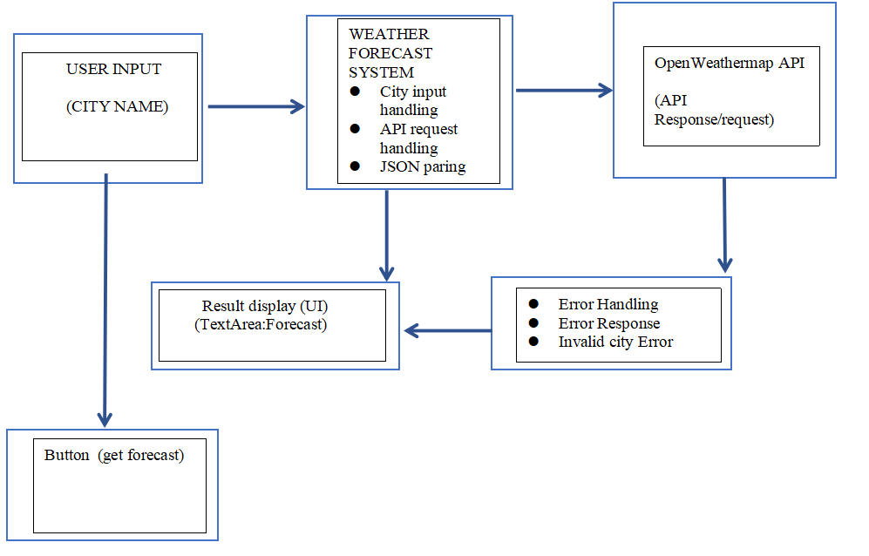
FLOW DIAGRAM

Slide 8
MODULE DESCRIPTION
1. User Interface:
The GUI is created using AWT components such as Frame, Label, TextField, Button, and TextArea.
The user enters the name of the city in the TextField.
When the user clicks the Get Forecast button, the application fetches the weather data for that city.
2.Weather Data Fetching:
The program sends a GET request to the OpenWeatherMap API with the entered city and the API key (replace with your own API key).
The fetchWeatherData method sends the HTTP request, retrieves the response, and returns the response body if the request is successful (response code 200).

Slide 9
MODULE DESCRIPTION
3.Parsing the Weather Data:
The response from the API is in JSON format. The code extracts temperature, humidity, and weather conditions by finding the relevant indices and substring values.
This data is displayed in the TextArea with a simple message about the weather, including the temperature, humidity, and condition.
4.Handling Errors:
If the user doesn't enter a city or if an error occurs while fetching the data, an appropriate error message is shown in the TextArea.

Slide 10
MERITS
1.Simple and Intuitive Design: The use of a straightforward graphical user interface (GUI) ensures that users can easily interact with the application. The input field, button, and output area are clearly labeled and easy to understand, making it accessible to users with basic computer skills.
Real-Time Weather Information: Users can quickly retrieve real-time weather data for any city, improving their convenience and helping them plan their activities or travel.
2. Real-Time Data Retrieval
OpenWeatherMap API Integration: By integrating with the OpenWeatherMap API, the system ensures that the data it provides is accurate and up-to-date. The user can rely on the application to give them the most current weather conditions without the need for manual updates.
Global Coverage: The application supports weather data for any city worldwide, thanks to the API’s broad coverage. This allows users to get weather forecasts for cities in any country or continent.

Slide 11
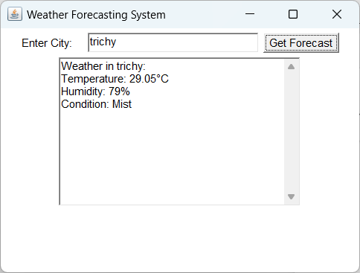
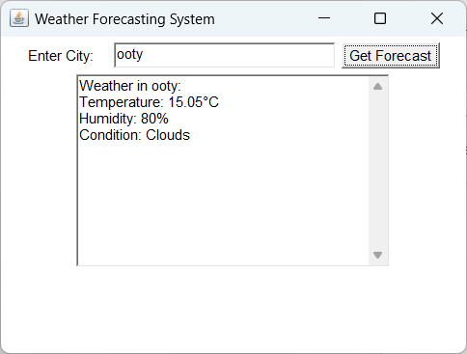
RESULT AND DISCUSSION

Slide 12
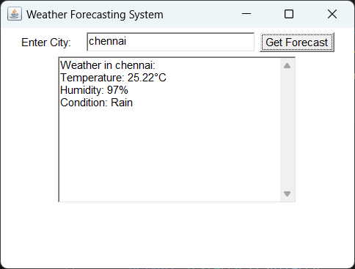
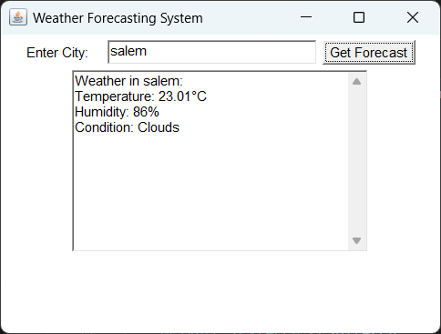
RESULT AND DISCUSSION

Slide 13
THANK YOU

